Slide 1

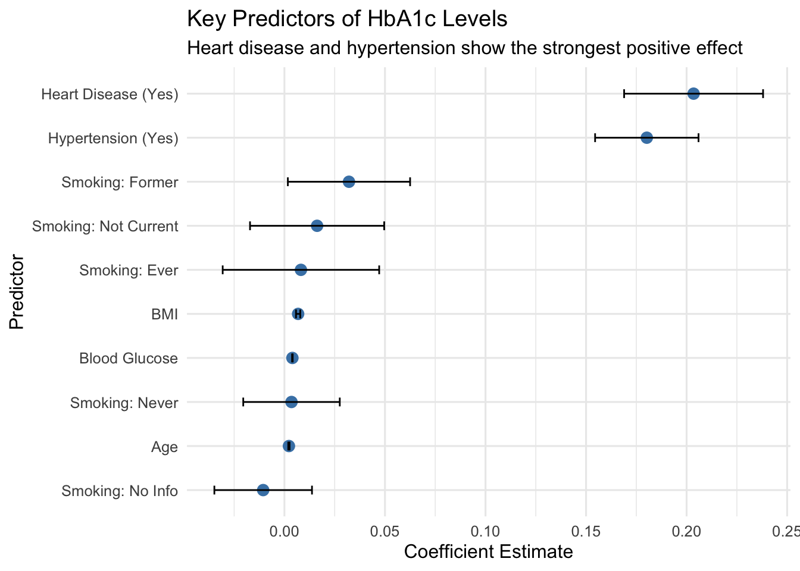
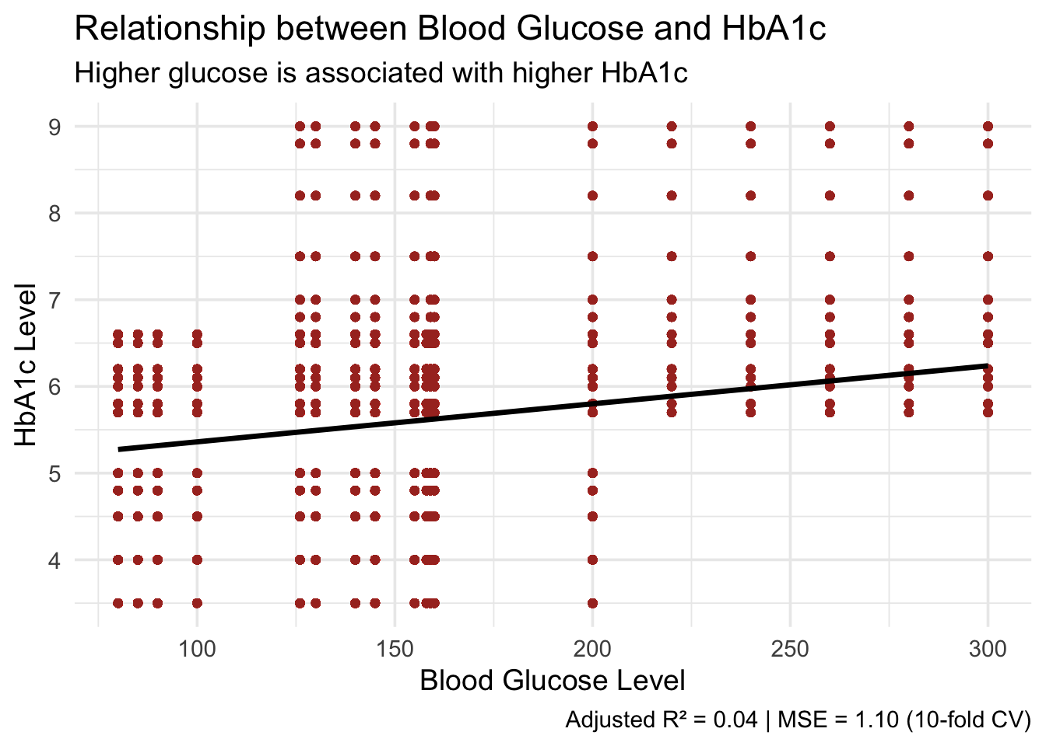
Predicting HbA1c Levels and Type II Diabetes Diagnosis with Demographic, Biometric, and Medical History Data
Thaina Gomez & Maxwell Miller-Golub STAT 627 – American University
Introduction/Context
Type II diabetes affects over 10% of adults, with nearly half undiagnosed (IDF, 2021). Early detection is critical for preventing complications.
RO1: Investigates whether demographic and biometric factors can predict HbA1c levels.
RO2:
Results/Implications
Even a simple model using routine health data can support early risk detection.
RO1: Predicting HbA1c may help flag patients needing further diabetes screening.
RO2:
Future work could include more predictors (e.g., diet, physical activity)
BMI, glucose, hypertension, & heart disease were significant predictors (p < 0.001).
The model explains a modest portion of variance & residuals met key model assumptions.
RO1
Approach
Cleaned and explored a dataset (N = 100,000) with predictors: age, BMI, glucose, hypertension, heart disease, and smoking history.
RO1: Built a multiple linear regression model for HbA1c using stepwise selection, assessed multicollinearity with VIF, and conducted residual diagnostics.
RO2:
Assumptions/Limitations/ Challenges or Secondary Results
RO1: Stepwise regression may overlook important interaction terms.
The model assumes linearity, independence, and constant variance; all were verified.
RO2:
The dataset may not represent all demographics equally.
Primary References
International Diabetes Federation. (2021). Diabetes facts & figures. https://idf.org/about-diabetes/diabetes-facts-figures/
Data
Mustafa, M. (n.d.). Diabetes prediction dataset. Kaggle. Retrieved March, 2025, from https://www.kaggle.com/datasets/iammustafatz/diabetes-prediction-dataset
Size: 100,000 patient records Scale: Demographics, biometric info (age, BMI, blood glucose), and medical history (heart disease, hypertension, smoking)
Acknowledgments
Professor Ahmad Mousavi
STAT 427/627-001 Spring 2025

